Slide 1
Introduction to Mathematical Programming
MA/OR 504
Chapter 7
Machine Learning:
Discriminant Analysis
Neural Networks
6-<number>

Slide 2
Part 1: Discriminant Analysis and Mahalanobis Distance
Chapter 7

Slide 3
Introduction to
Discriminant Analysis (DA)
DA is a statistical technique that uses information from a set of independent variables to predict the value of a discrete or categorical dependent variable.
The goal is to develop a rule for predicting to which of two or more predefined groups a new observation belongs based on the values of the independent variables.
Examples:
  Credit Scoring
    Will a new loan applicant: (1) default, or (2) repay?
  Insurance Rating
    Will a new client be a: (1) high, (2) medium or (3) low risk?

Slide 4
Types of DA Problems
2 Group Problems...
    …regression can be used
k-Group Problem (where k>=2)...
    …regression cannot be used if k>2

Slide 5
Example of a 2-Group DA Problem:
ACME Manufacturing
All employees of ACME manufacturing are given a pre-employment test measuring mechanical and verbal aptitude.
Each current employee has also been classified into one of two groups: satisfactory or unsatisfactory.
We want to determine if the two groups of employees differ with respect to their test scores.
If so, we want to develop a rule for predicting whether new applicants will be satisfactory or unsatisfactory.

Slide 6
The Data
See file Fig7-1.xls

Slide 7
Graph of Data for Current Employees
45
Group 1 centroid
40
Group 2 centroid
C₁
Verbal Aptitude
35
C₂
30
Satisfactory Employees
Unsatisfactory Employees
25
25
30
35
40
45
50
Mechanical Aptitude

Slide 8
Calculating Discriminant Scores
where
  X₁ = mechanical aptitude test score
  X₂ = verbal aptitude test score
For our example, using regression we obtain,
Figure 7-2

Slide 9
A Classification Rule
If an observation’s discriminant score is less than or equal to some cutoff value, then assign it to group 1; otherwise assign it to group 2
What should the cutoff value be?

Slide 10
Possible Distributions of Discriminant Scores
Group 1
Group 2
Cut-off Value

Slide 11
Cutoff Value
For data that is multivariate-normal with equal covariances, the optimal cutoff value is:
For our example, the cutoff value is:
Even when the data is not multivariate-normal, this cutoff value tends to give good results.

Slide 12
Calculating Predicted Group
See file Fig7-3.xls

Slide 13
A Refined Cutoff Value
Costs of misclassification may differ.
Probability of group memberships may differ.
The following refined cutoff value accounts for these considerations:

Slide 14
Classification Accuracy
Predicted
Group
1 2 Total
Actual 1 9 2 11
Group 2 2 7 9
Total 11 9 20
Accuracy rate = 16/20 = 80%

Slide 15
Classifying New Employees
See file Fig7-4.xls

Slide 16
The k-Group DA Problem
Suppose we have 3 groups (A=1, B=2 & C=3) and one independent variable.
We could then fit the following regression function:
The classification rule is then:
If the discriminant score is:
Assign observation to group:
A
B
C

Slide 17
Graph Showing Linear Relationship
Y
3
2
1
Group A
Group B
Group C
0
0
1
2
3
4
5
6
7
8
9
10
11
12
13
X

Slide 18
The k-Group DA Problem
Now suppose we re-assign the groups numbers as follows: A=2, B=1 & C=3.
The relation between X & Y is no longer linear.
There is no general way to ensure group numbers are assigned in a way that will always produce a linear relationship.

Slide 19
Graph Showing Nonlinear Relationship
Y
3
2
1
Group A
Group B
Group C
0
0
1
2
3
4
5
6
7
8
9
10
11
12
13
X

Slide 20
Example of a 3-Group DA Problem:
ACME Manufacturing
All employees of ACME manufacturing are given a pre-employment test measuring mechanical and verbal aptitude.
Each current employee has also been classified into one of three groups: superior, average, or inferior.
We want to determine if the three groups of employees differ with respect to their test scores.
If so, we want to develop a rule for predicting whether new applicants will be superior, average, or inferior.

Slide 21
The Data
See file Fig7-5.xls

Slide 22
Graph of Data for Current Employees
45.0
Group 1 centroid
40.0
Group 3 centroid
C₂
C₁
Verbal Aptitude
35.0
C₃
30.0
Superior Employees
Group 2 centroid
Average Employees
Inferior Employees
25.0
25.0
30.0
35.0
40.0
45.0
50.0
Mechanical Aptitude

Slide 23
The Classification Rule
Compute the distance from the point in question to the centroid of each group.
Assign it to the closest group.

Slide 24
Distance Measures
Euclidean Distance
This does not account for possible differences in variances.

Slide 25
99% Contours of Two Groups
X₂
P₁
C₂
C₁
X₁

Slide 26
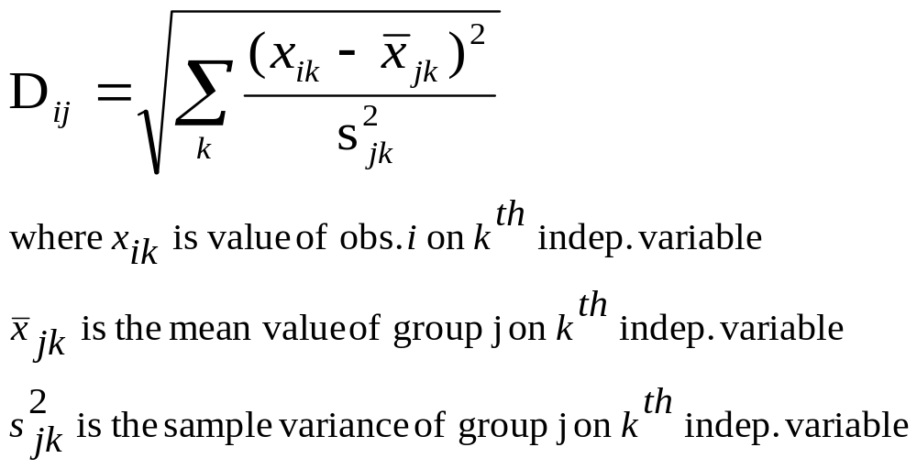
Distance Measures
Variance-Adjusted Distance
This can be adjusted further to account for differences in covariances.
The DA.xla add-in uses the Mahalanobis distance measure.

Slide 27
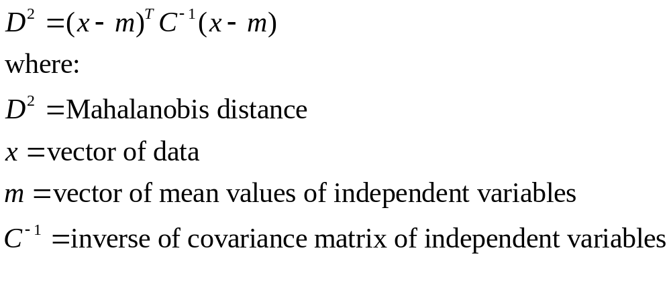
Mahalanobis Distance

Slide 28
Using the DA.XLA Add-In
See file Fig7-6.xls
For detail, see
See file Fig. 7-7

Slide 29
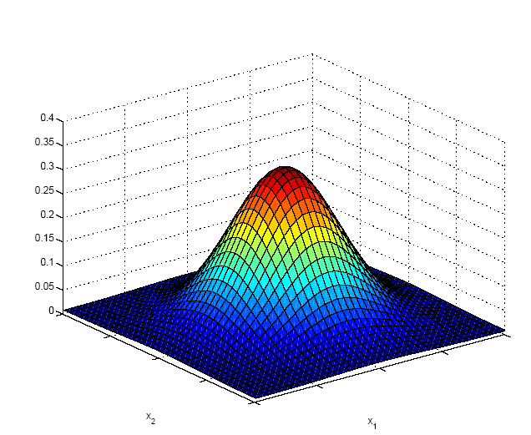
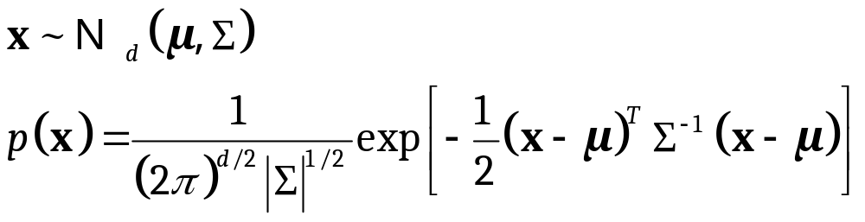
Multivariate Normal Distribution
Covariance Matrix

Slide 30
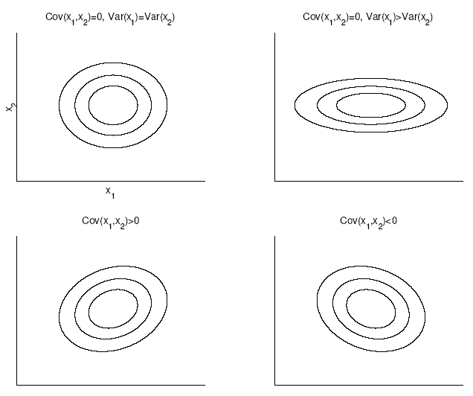
Bivariate Normal
If X and Y are independent then Cov(X, Y)=0. However, if Cov(X, Y)=0 then X and Y may not be independent.

Slide 31
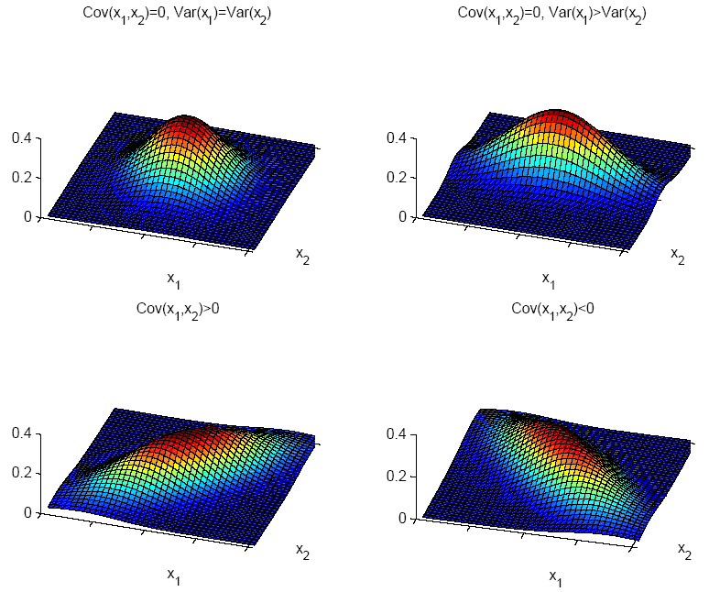

Slide 32
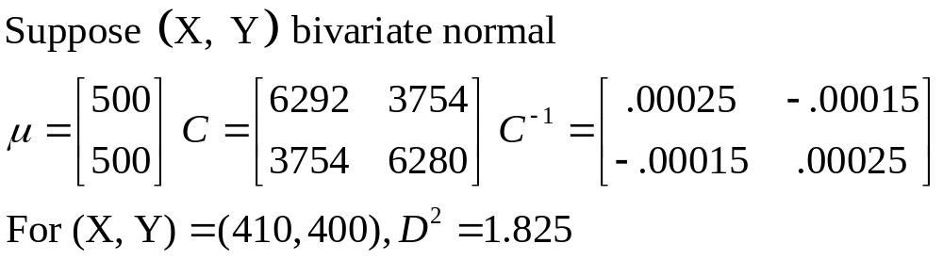
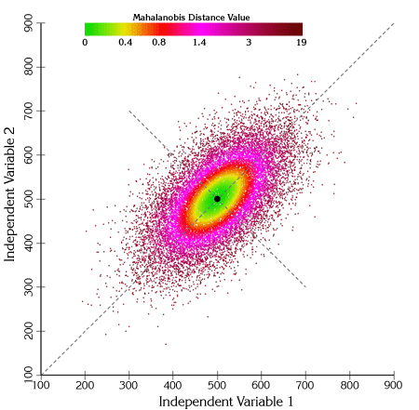
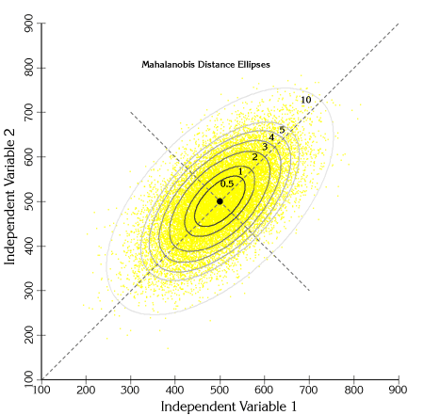
Example

Slide 33
MBA Admissions
Salterdine Univ wants to use DA to determine which applicants to admit to the MBA program.
Director believes undergraduate GPA and GMAT score provide useful information for predicting which applicants will be good students.
Faculty classify 30 current students in the MBA program into 2 groups: 1) good students, 2) weak students.
Information for 5 new applicants has been received by the director.
See Fig. 7-8

Slide 34
Bank Loans
Commercial loan dept. mgr. evaluates loan applications.
Important company characteristics for evaluating loan application:
  Liquidity (ratio of current assets to current liabilities)
  Profitability (ratio of net profit to sales)
  Activity (ratio of sales to fixed assets)
18 past loans bank has made are categorized
  Acceptable
  One or two late payments
  Unacceptable, 3 or more late payments
Must evaluate 5 new loan applications
Fig. 7-9

Slide 35
End of Chapter 7

